Slide 1
Chapter 11 Advanced Database Concepts
11.1 Object Oriented Model
11.2 Object Relational Model
11.3 Object Relational Mapping
11.4 Distributed Database
11.5 Data Warehouse

Slide 2
11.1 Object Oriented Model
An object-oriented database is a database that subscribes to a model with information represented by objects.
Object-oriented databases are a niche offering in the relational database management system (RDBMS) field and are not as successful or well-known as mainstream database engines.
Object oriented data model is based upon real world situations.
These situations are represented as objects, with different attributes.
All these object have multiple relationships between them.

Slide 3
11.1 Object Oriented Model
It maintains correspondence between real world and database objects without loosing integrity and identity.
Object has state and behavior
Entity is represented as a class.
Instances of the class are objects.
Within an object , the class attributes takes specific values.

Slide 4
11.1 Object Oriented Model
Elements of object oriented model
Object
Attributes
Methods
Class

Slide 5
11.2 Object Relational Model
An Object relational model is a combination of a Object oriented database model and a Relational database model.
So, it supports objects, classes, inheritance etc. just like Object Oriented models and has support for data types, tabular structures etc. like Relational data model.
One of the major goals of Object relational data model is to close the gap between relational databases and the object oriented practices frequently used in many programming languages such as C++, C#, Java etc.

Slide 6
11.2 Object Relational Model
Objects, classes and inheritance are directly supported in database schemas and in the query language.
In addition, just as with pure relational systems, it supports extension of the data model with custom data types and methods.
An object–relational database can be said to provide a middle ground between relational databases and object-oriented databases.
In object–relational databases, the approach is essentially that of relational databases:
the data resides in the database and is manipulated collectively with queries in a query language;
at the other extreme are OODBMS in which the database is essentially a persistent object store for software written in an object-oriented programming language, with a programming API for storing and retrieving objects, and little or no specific support for querying.

Slide 7
11.3 Object Relational Mapping
ORM is a programming technique for converting data between incompatible type systems into object oriented programming language.
This creates a virtual object database , which can be used from within the programming language.
It is necessary because objects are almost non-scales values while the DBMS can only store and manipulate scalar values organized within tables.
ORM convert object values into group of singular values for storages in the database.

Slide 8
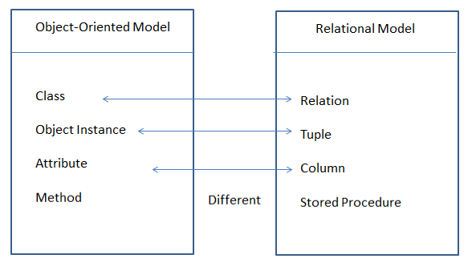
Object v/s Relational Model

Slide 9
11.4 Distributed Database
The database is stored on several computers known as sites.
Each site is largely coupled.
There is no any stored physical component.
Communication between sites is done with network.
Local transaction access data only from site where it was initiated.
Global transaction access data from different sites.

Slide 10
11.4.1 Heterogeneous Database
Each site uses different schema.
Difficulty in query and transaction processing.
Provide limited facility for cooperation
Also, a particular site might be completely unaware of the other sites.
Different computers may use a different operating system, different database application.

Slide 11
11.4.2 Homogeneous Database
All sites have identical dbms software
The operating system, database management system and the data structures used – all are same at all sites.
Agree to cooperate in processing user requests.
Each site surrender part of anatomy as a right to change schema
It appears as a single system for users.

Slide 12
11.4.3 Data replication
Approach to store distributed data in which system contains multiple copies of data in different sites.
Full replication indicates storing at all sites,
Fully redundant indicates each site having entire copy of database.
It ensures availability ,parallelism and reduced data transfer
Update cost is high
Difficult for concurrency control

Slide 13
11.4.4 Data fragmentation
Approach to store distributed in which relation r is divided.
Fragments with sufficient information to reconstruct r
Each schema should have common candidate key to ensure lossless join.
In horizontal each tuple of r is assigned to one or more fragments
It allows parallel processing and easy access.
In vertical schema is split into several smaller schemes
It allows parallel processing on relation

Slide 14
11.5 Data Warehouse
Data warehouse is a single ,complete and consistent data store obtained from a variety of sources made available to end users in the understandable form and used as a business context.
It is subject oriented, integrated , time-variant and non-volatile collection of data to support decision making process.

Slide 15
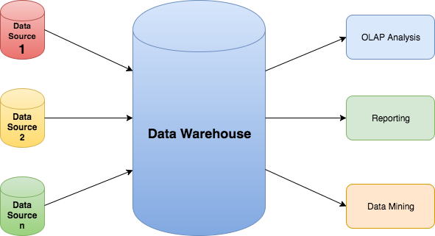
11.5 Data Warehouse

Slide 16
11.5.1 Need for Data Warehouse
Business User: Business users require a data warehouse to view summarized data from the past. Since these people are non-technical, the data may be presented to them in an elementary form.
Store historical data: Data Warehouse is required to store the time variable data from the past. This input is made to be used for various purposes.
Make strategic decisions: Some strategies may be depending upon the data in the data warehouse. So, data warehouse contributes to making strategic decisions.

Slide 17
11.5.1 Need for Data Warehouse
For data consistency and quality: Bringing the data from different sources at a commonplace, the user can effectively undertake to bring the uniformity and consistency in data.
High response time: Data warehouse has to be ready for somewhat unexpected loads and types of queries, which demands a significant degree of flexibility and quick response time.

Slide 18
Assignment
Advantages and Disadvantages of OODBMS
Difference between OODBMS and ORDBMS
Advantages of Distributed Database
Distributed v/s Parallel Processing
Advantages and disadvantages of data warehouse
OLAP v/s OLTP

Slide 19
This is the end of the lecture!
I hope you enjoyed it.
Thank You

